Slide 1
Updates 8/4/20
Akash Levy

Slide 2
Overview
Sweep plot for FPPV
Sweep plots for VWL and VBL
Retention distribution plots
Retention BER plot
ISPP optimization results
SDCFC optimization results
ISPP/FPPV evaluation on chip 1

Slide 3
TODO List (In Order)
Optimize ISPP
Evaluate ISPP on 4K more cells and add to previously collected data
Optimize SDR SL over 256 cells
Sweep step size from 0.02 to 0.22 in steps of 0.04 (6)
Sweep start voltage from 0 to 1 in steps of 0.2 (6)
Total: 36
Optimize SDR BL over 256 cells
Sweep step size from 0.02 to 0.22 in steps of 0.04 (6)
Sweep start voltage from 0 to 1.2 in steps of 0.4 (4)
Total: 24
Optimize SDR SL over 256 cells
Sweep step size from 0.02 to 0.22 in steps of 0.04 (6)
Sweep start voltage from 0 to 1.2 in steps of 0.4 (4)
Total: 24
Evaluate SDCFC on 8K cells (addr 10240 -> 8K)
Redo sweeps on 50 cells with 10 per cell using proper step sizes
7.5 kOhm slope measurement
0.05V step size starting from 0V
Evaluate FPPVv2 on 8K cells (with 2000 attempts)
Endurance testing
2bpc repeat all steps above
Chip 2
Do FPPV sweep and find coarse settings
Redo evaluation on 8K cells
Redo endurance testing

Slide 4
Sweep Plots
Slope comparisons for different knobs, and FPPV results

Slide 5
Sweep Plots: FPPV VWL Chip 1

Slide 6
Sweep Plots: SET VWL

Slide 7
Sweep Plots: RESET VWL

Slide 8
Sweep Plots: SET VBL

Slide 9
Sweep Plots: RESET VSL

Slide 10
3bpc Algorithms
Optimization and experimental results

Slide 11
Resistance Ranges
 | Rmin | Rmax | Rwmin | Rwmax
Range 0 | N/A | 4.3k | N/A | 4.2k
Range 1 | 4.38k | 4.75k | 4.54k | 4.58k
Range 2 | 4.84k | 5.3k | 5.04k | 5.09k
Range 3 | 5.42k | 6.01k | 5.67k | 5.73k
Range 4 | 6.16k | 6.99k | 6.51k | 6.59k
Range 5 | 7.19k | 8.9k | 7.71k | 7.87k
Range 6 | 9.2k | 25k | 11.42k | 11.93k
Range 7 | 20k | N/A | 80k | N/A

Slide 12
ISPP Optimization Results

Slide 13
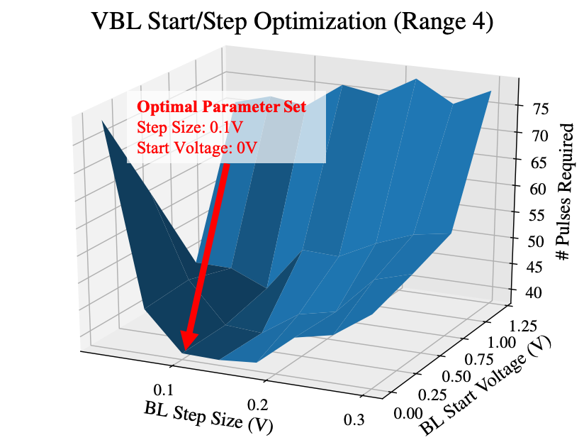
VBL Step Size Optimization

Slide 14
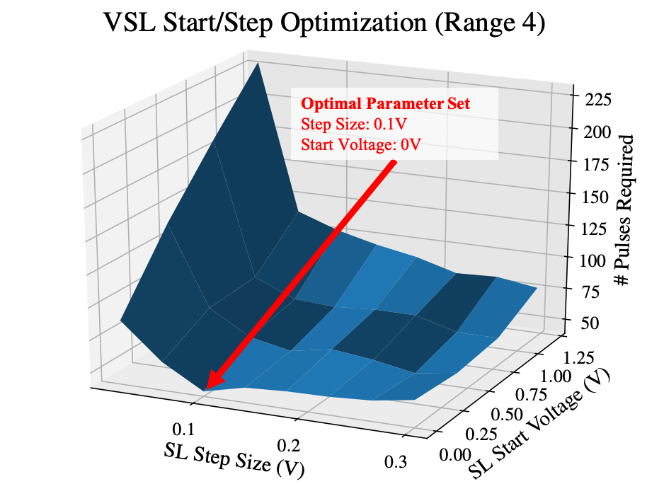
VSL Step Size Optimization

Slide 15
Optimization Parameters
 | VBL Start (V) | VBL Step (V) | VSL Start (V) | VSL Step (V)
Range 0 | 2 | 0.3 | N/A | N/A
Range 1 | 0 | 0.14 | 0 | 0.14
Range 2 | 0 | 0.1 | 0 | 0.1
Range 3 | 0 | 0.1 | 0 | 0.1
Range 4 | 0 | 0.1 | 0 | 0.1
Range 5 | 0 | 0.06 | 0 | 0.06
Range 6 | 0 | 0.06 | 0 | 0.1

Slide 16
Algorithm evaluation on 4 WLs: chip 1

Slide 17
Algorithm evaluation on 4 WLs: chip 2

Slide 18
3bpc algorithm evaluation on 4 WLs
Chip # | Cycles | SDCFC | ISPP | FPPV
1 | 300 | 36.44 | 86.10 | >90
2 | 300 | 35.88 | >90 | >90
1 | 8k | 35.19 | >90 | >90
2 | 8k | TODO | >90 | >90
Notes:
92.95 for chip 2 ISPP

Slide 19
2bpc Algorithms
Optimization and experimental results

Slide 20
Resistance Ranges
 | Rmin | Rmax | Rwmin | Rwmax
Range 0 | N/A | 5.10k | N/A | 5.00k
Range 1 | 5.38k | 6.48k | 5.77k | 6.01k
Range 2 | 6.93k | 12.00k | 8.51k | 9.31k
Range 3 | 20.00k | N/A | 80k | N/A

Slide 21
ISPP Optimization Results

Slide 22
VBL Step Size Optimization

Slide 23
VSL Step Size Optimization

Slide 24
Optimization Parameters
 | VBL Start (V) | VBL Step (V) | VSL Start (V) | VSL Step (V)
Range 0 | 2 | 0.3 | N/A | N/A
Range 1 | 0.6 | 0.18 | 0.6 | 0.26
Range 2 | 0.8 | 0.1 | 0.6 | 0.34

Slide 25
Algorithm evaluation on 4 WLs: chip 1

Slide 26
Algorithm evaluation on 4 WLs: chip 2

Slide 27
2bpc algorithm evaluation on 4 WLs
Chip # | Cycles | SDCFC | ISPP | FPPV
1 | 300 | 8.52 | 20.51 | 15.75
2 | 300 | 8.50 | 21.62 | 16.83
1 | 8k | 9.56 | >25 | >25
2 | 8k | 9.39 | >25 | >25

Slide 28
Retention
Distributions (empirical and predicted)

Slide 29
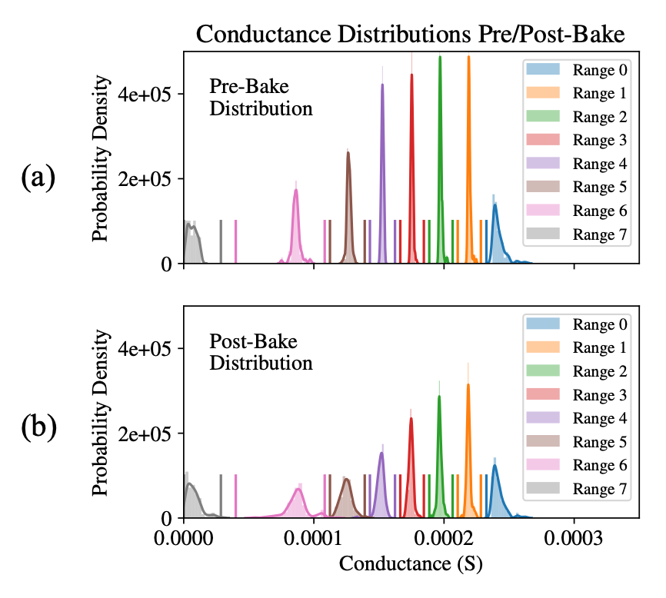
Combined Distribution Plot

Slide 30
Retention model plot

Slide 31
Retention BER plot

Slide 32
Comparison Table

Slide 33
Comparison References

Slide 34
Backup
Things we will show only if reviewers or co-authors ask

Slide 35
3bpc Pre-Optimization Parameters
 | VBL Start (V): Seed | VBL Step (V): Seed | VSL Start (V) | VSL Step (V)
Range 0 | 0.4 | 0.04 | N/A | N/A
Range 1 | 0.4 | 0.04 | 0.6 | 0.18
Range 2 | 0.4 | 0.04 | 0.2 | 0.22
Range 3 | 0.4 | 0.04 | 0.4 | 0.14
Range 4 | 0.4 | 0.04 | 0.4 | 0.14
Range 5 | 0.4 | 0.04 | 0.4 | 0.14
Range 6 | 0.4 | 0.04 | 0.4 | 0.14

Slide 36
2bpc Pre-Optimization Parameters
 | VBL Start (V): Seed | VBL Step (V): Seed | VSL Start (V) | VSL Step (V)
Range 0 | 2 | 0.3 | N/A | N/A
Range 1 | 0 | 0.04 | 0 | 0.16
Range 2 | 0 | 0.04 | 0 | 0.1

Slide 37
BER Plot at 100 Pulses

Slide 38
Retention BER plot full

Slide 39
Combined Pre/Post-Bake Distribution Plot
(a)
(b)

Slide 40
VBL Optimization
Optimal Parameter Set
Step Size: 0.1V
Start Voltage: 0V

Slide 41
VSL Optimization 1

Slide 42
VSL Optimization 2
Optimal Parameter Set
Step Size: 0.1V
Start Voltage: 0V

Slide 43
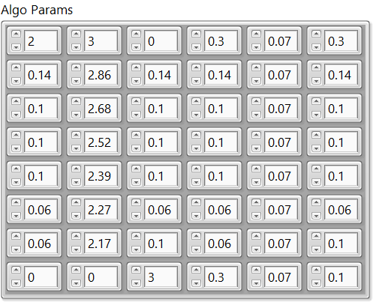
Algorithm Parameters

